Slide 1
Assignment 1: Damped Wave Simulation with OpenMP
A 2D damped wave solved with central differences, parallelized on HPC@PoliTO (edu_skylake, edu_sapphire)
Finding: the ceiling is I/O, synchronization and NUMA placement — not the stencil

Slide 2
A three-matrix stencil, parallelized once outside the time loop
Numerical scheme
Central differences on a regular Δx, Δy, Δt grid
u_past, u, u_fut hold t−1, t and t+1
Zero everywhere except one impulse at the centre
Pointer rotation replaces deep-copying matrices
OpenMP structure
One parallel region opened before the time loop
collapse(2) fuses i and j into one M×M space
Each thread owns a disjoint set of coordinates
The writing thread also rotates, so the swap is safe
Per-timestep sequence
stencil update
(omp for, collapse(2))
scale into
pixel buffer
one fwrite
(omp single)
rotate
u_past / u / u_fut
Parameters throughout: impulse −49 at the grid centre, propagation speed c = 0.33, damping γ = 0.187.

Slide 3
Profiling pointed at the barrier, not the stencil
VTune Hotspots at M=1000 on 32 threads: 79.4% of CPU time in gomp_team_barrier_wait_end, 9.7% in fwrite, 2.2% in the stencil.
1. Buffered frame output
Per-pixel fwrite replaced by one in-memory buffer, filled in parallel and flushed with a single call per frame.
2. Loop fusion
Stencil and buffer-fill span the same (i,j) range, so they were merged into one omp for, removing the added barrier.
3. Parallel first-touch init
Initialization parallelized with the stencil's schedule, so each thread first-touches the pages it later reuses.
57.5%
barrier wait, from 79.4%
15.7%
stencil, from 2.2%
<0.3%
fwrite, from 9.7%
Threading analysis still reported 23% CPU utilization — 7.36 effective threads out of 32 — so at M=1000 the workload was too small for the team size. schedule(guided) was retained here because it absorbs the imbalance of the single-threaded write.

Slide 4
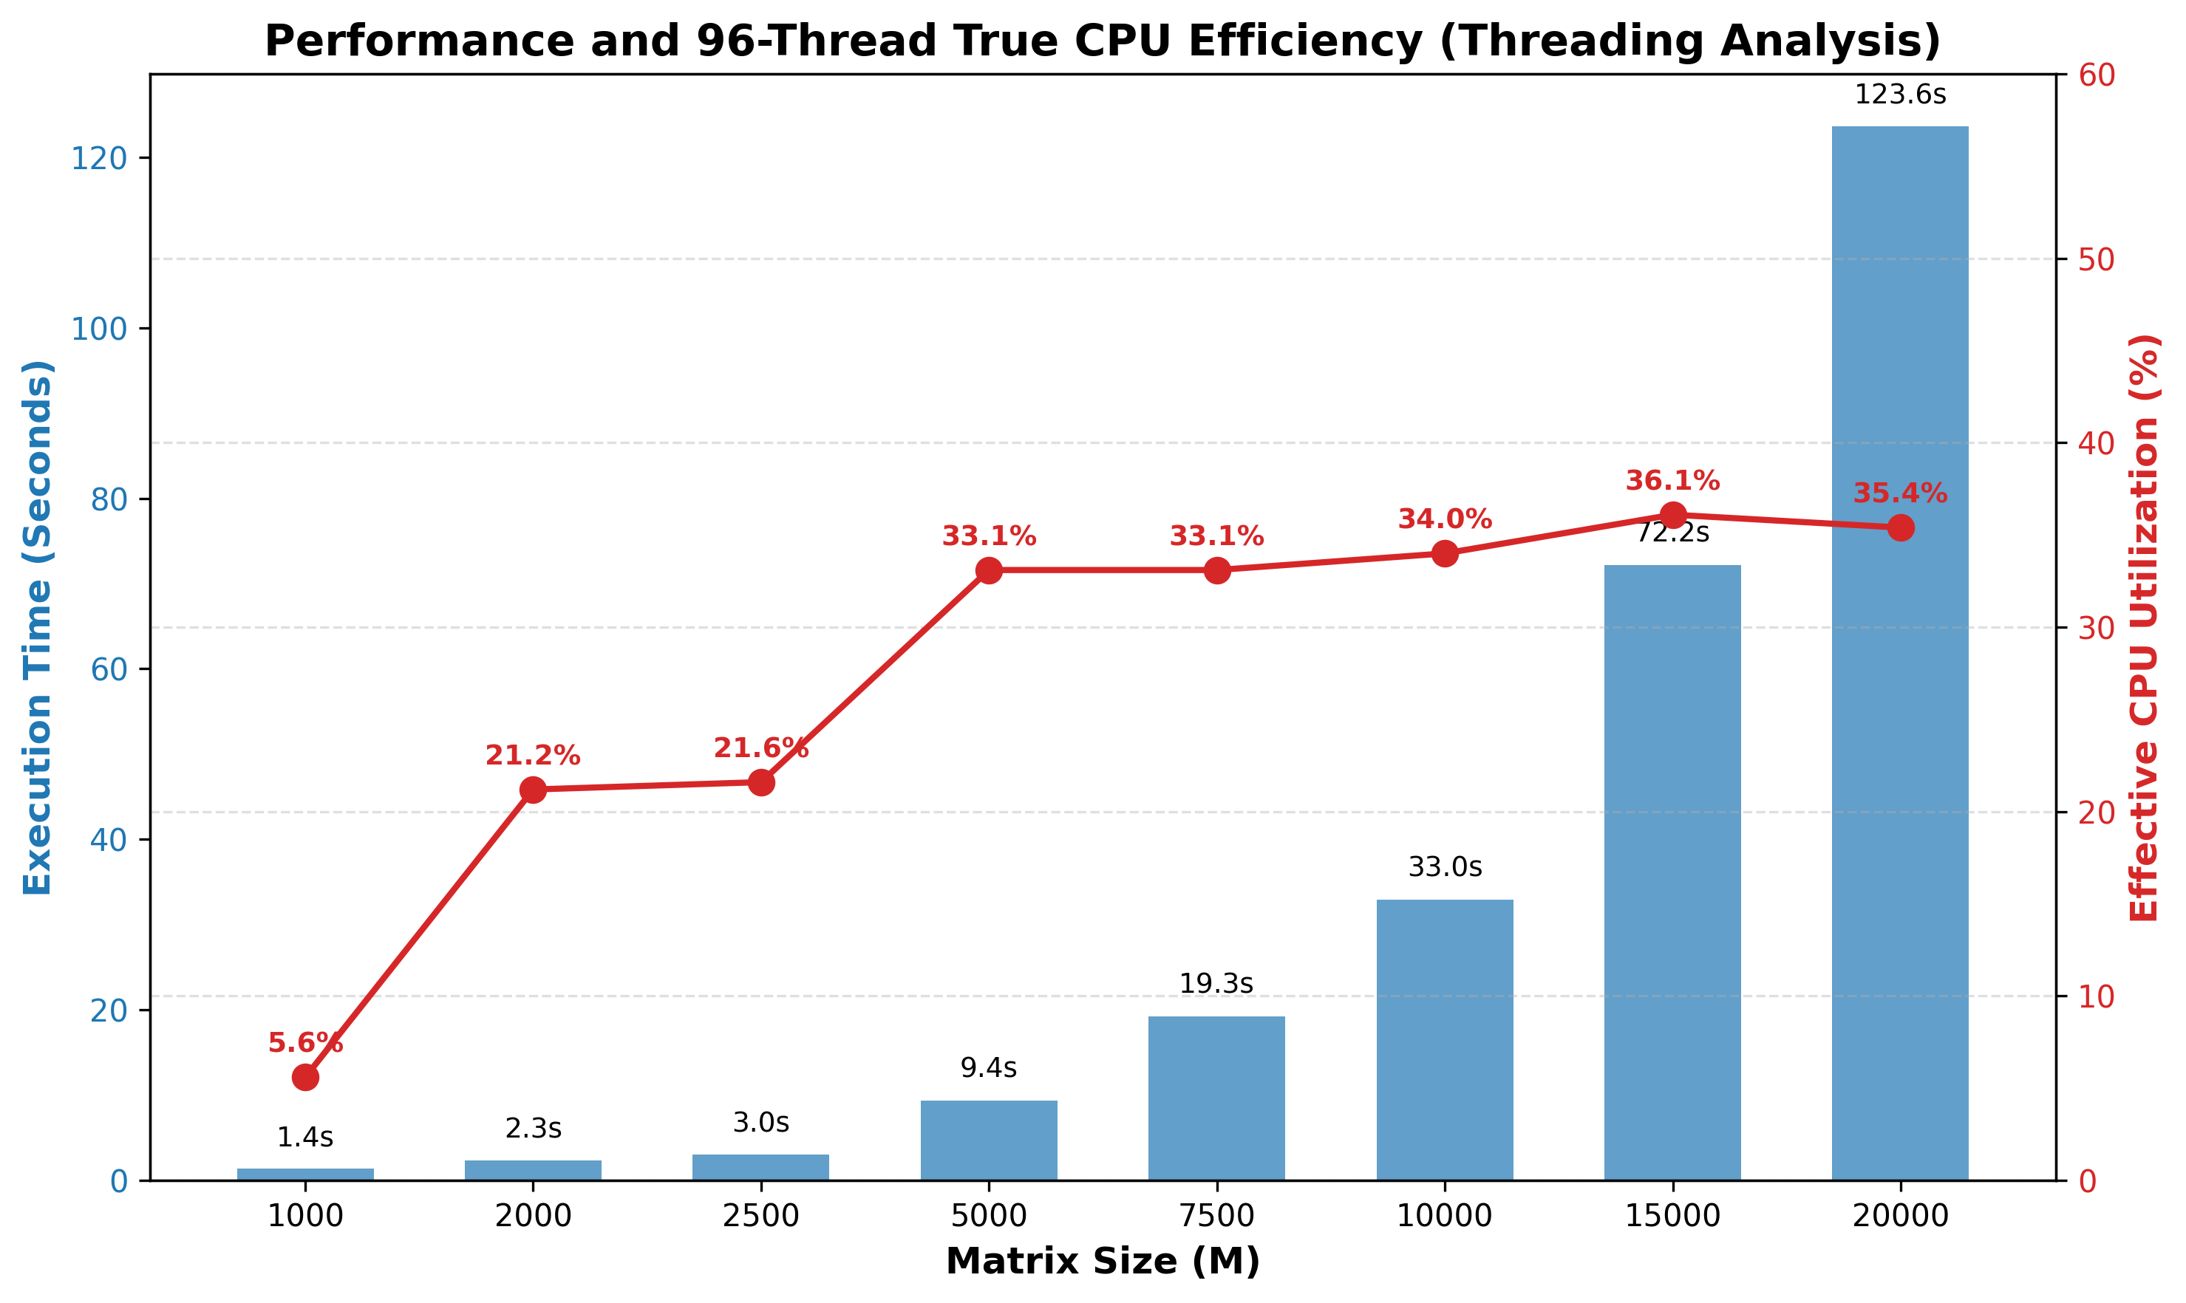
CPU utilization climbs to 36% and stops there
Execution time and effective CPU utilization across grid size M, 96 threads on edu_sapphire. Below M=2500 the threads starve; M=10000→20000 costs 3.74× against an ideal 4×.

Slide 5
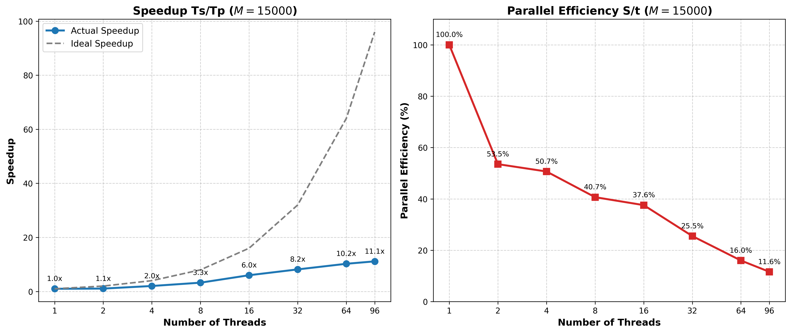
At M=15000, 96 threads return only 11.1× speedup
Full pipeline with I/O. Up to 32 threads every thread owns a physical core and the loss is barrier cost; past 48 cores the rest are SMT siblings, and efficiency ends at 11.6%.

Slide 6
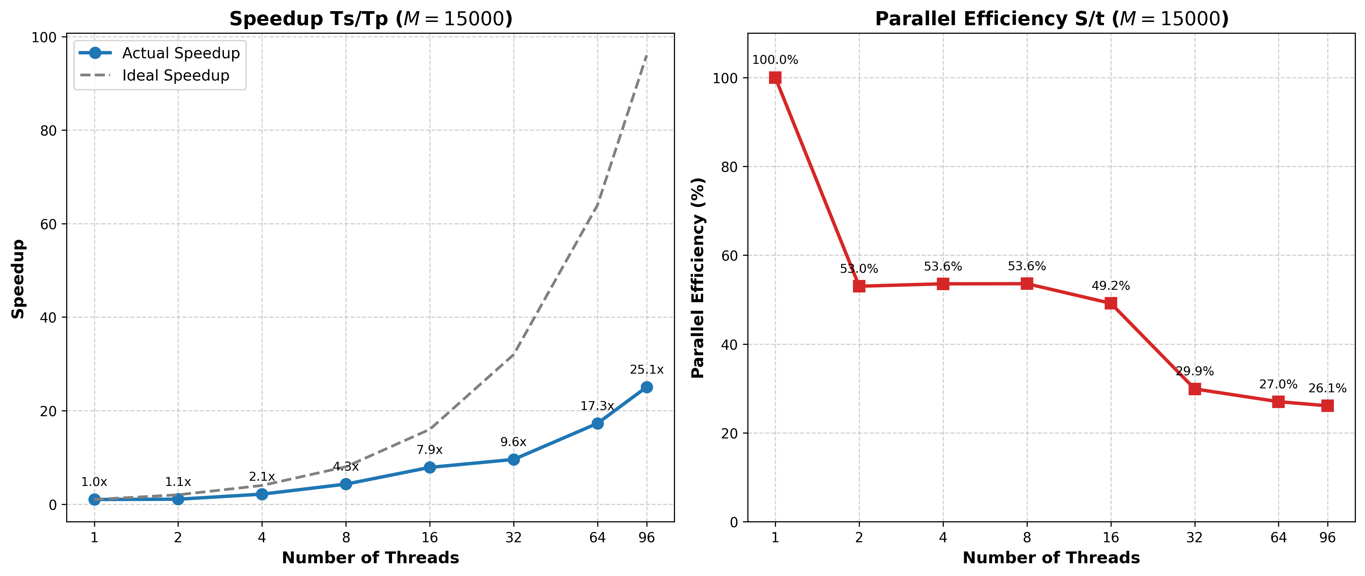
Disabling I/O more than doubles speedup, to 25.1×
Same sweep, frame writes removed. At 96 threads speedup goes 11.1× → 25.1× and efficiency 11.6% → 26.1%: the overhead was the writes and their barriers, not the stencil.

Slide 7
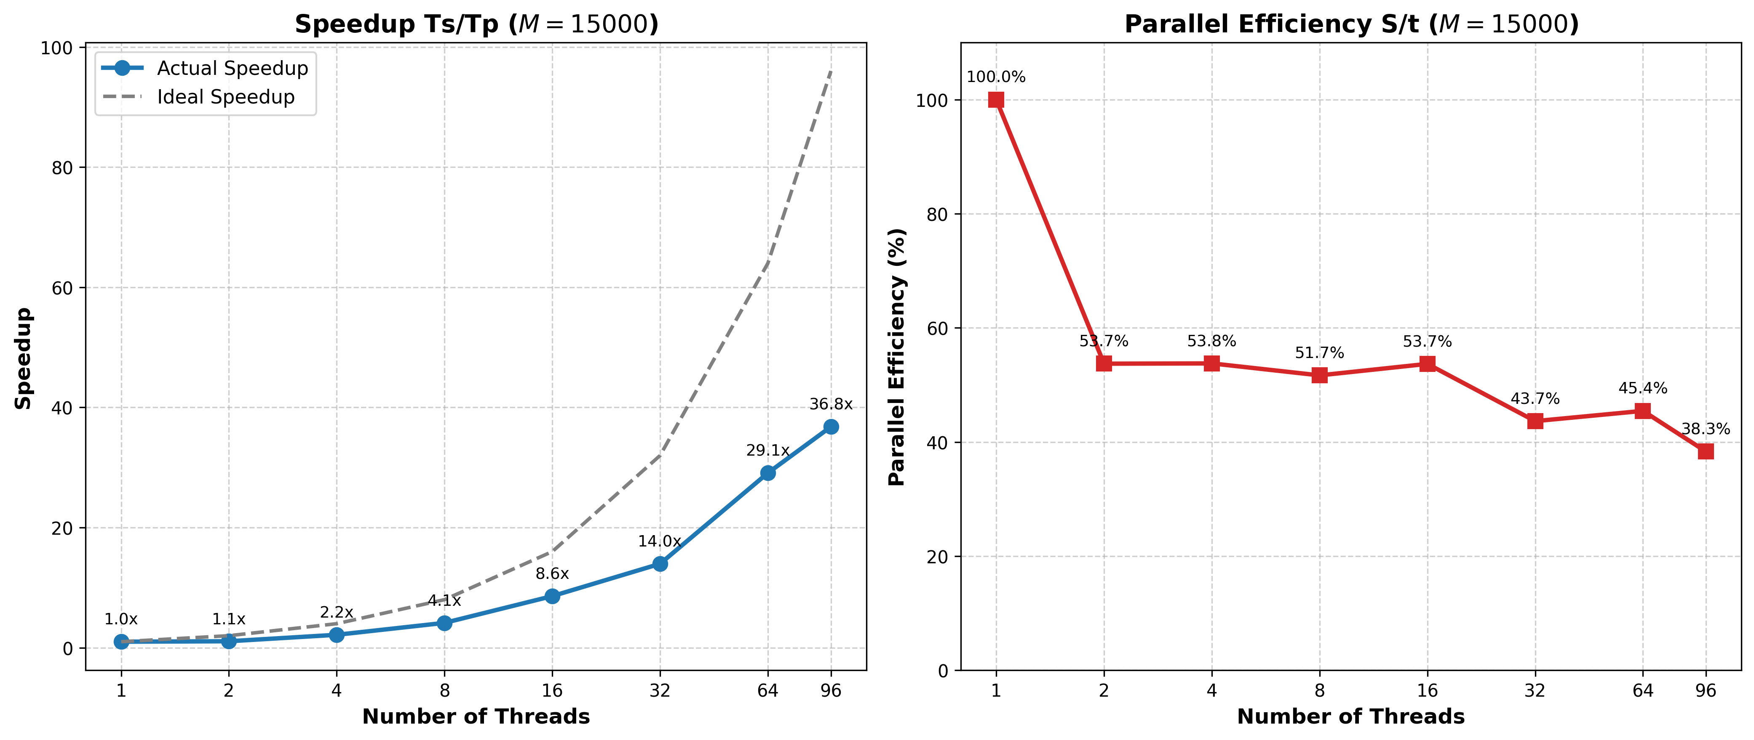
NUMA-aligned static scheduling takes it to 36.8×
I/O disabled, schedule(static) in both init and stencil, so each thread keeps the rows it first touched. Efficiency 43.7% vs. 29.9% at P=32, 45.4% vs. 27.0% at P=64.

Slide 8

Colorized Wave Simulation on GPU
Assignment 3 — MPI + OpenMP + CUDA
Profiled on HPC@PoliTO (Legion), edu_a40 and edu_v100
Finding: the bottleneck is file I/O, not compute

Slide 9
Three independent scenarios, one shared GPU
Per-rank pipeline
3 MPI ranks, one scenario each
OpenMP 5-point Laplacian stencil
CUDA kernel maps each value to RGB
Per-frame adaptive colour scale
ASCII P3 PPM frame written each step
Cluster: HPC@PoliTO (Legion)
edu_a40 — 2x24 cores + SMT, 4x A40
edu_v100 — 32 cores, 4x V100
Job requests --gres=gpu:1
All three ranks share one GPU
Nsight Compute blocked: ERR_NVGPUCTRPERM
Per-frame output path
compute_next
(OpenMP)
H2D copy
colorize
kernel
D2H copy
ASCII format
disk write
(fwrite)
These last two carry ~99% of the frame cost

Slide 10
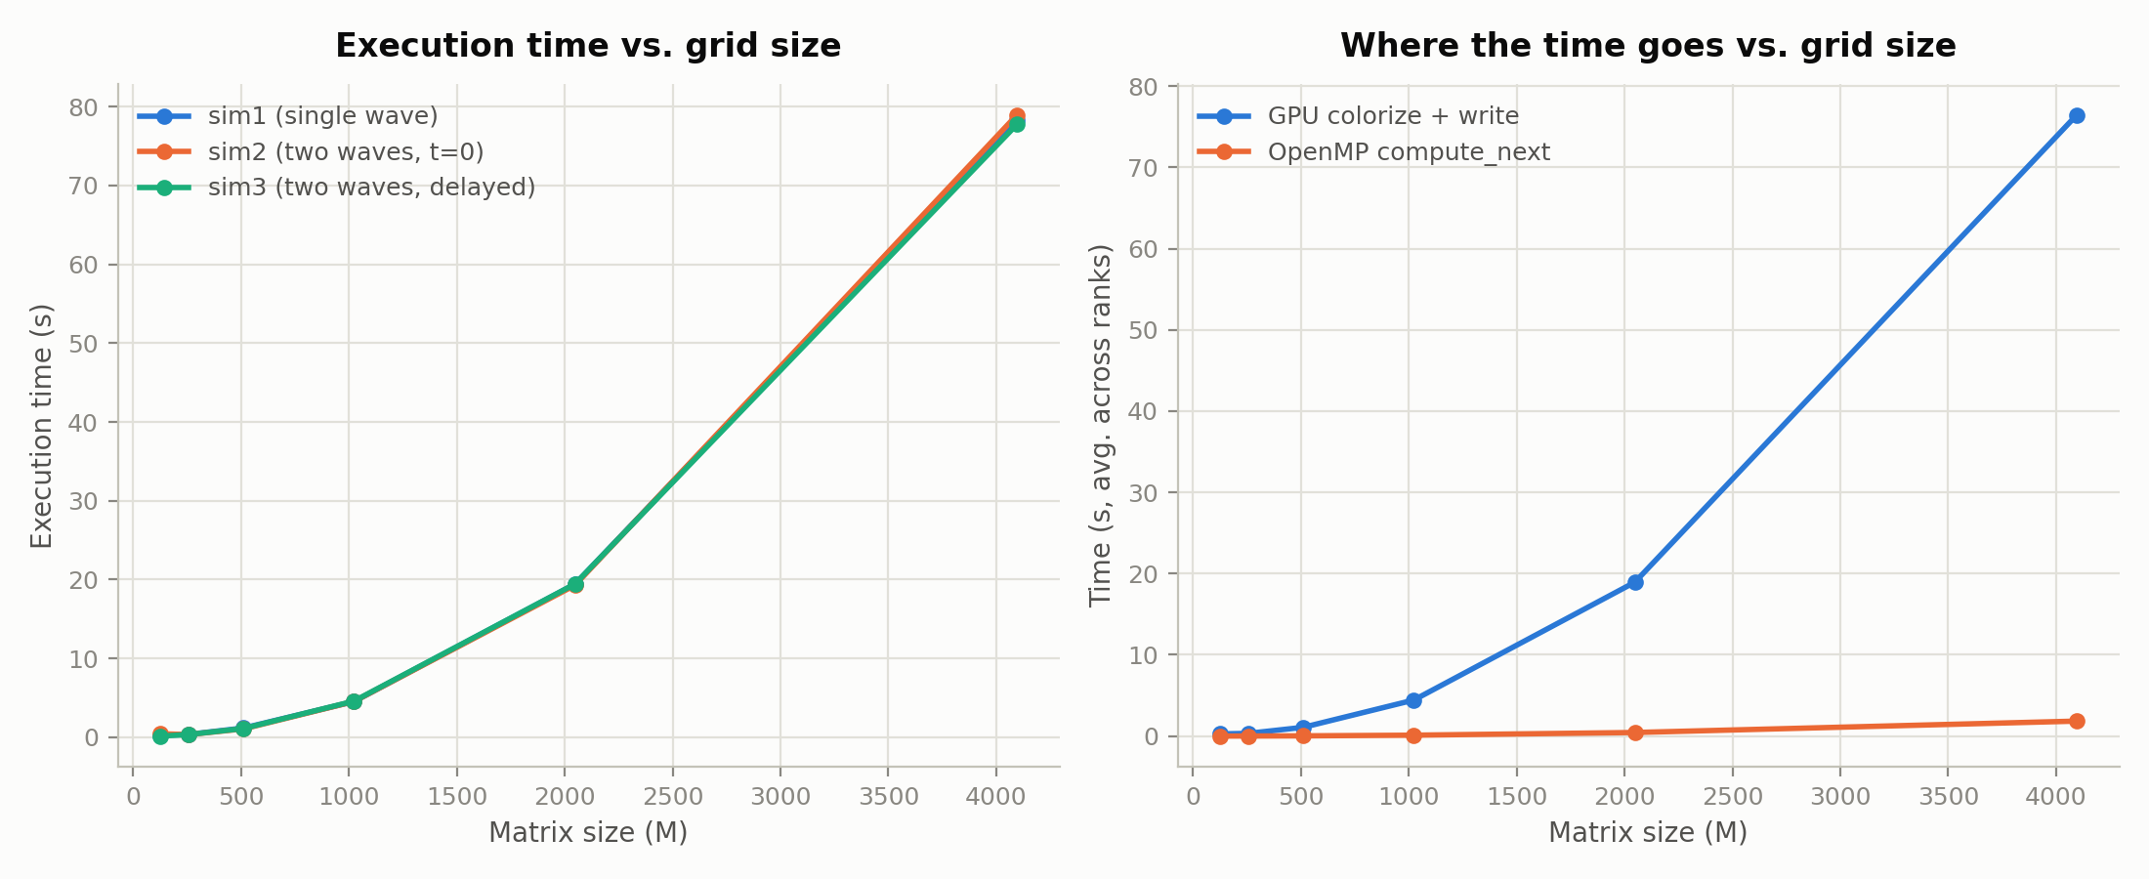
Near-ideal O(M²) scaling — and GPU colorize+write dominates throughout
2048 → 4096 costs 4.1× (ideal quadratic). At M=4096, GPU colorize+write is ~94.6% of total time; compute_next just ~2%.

Slide 11
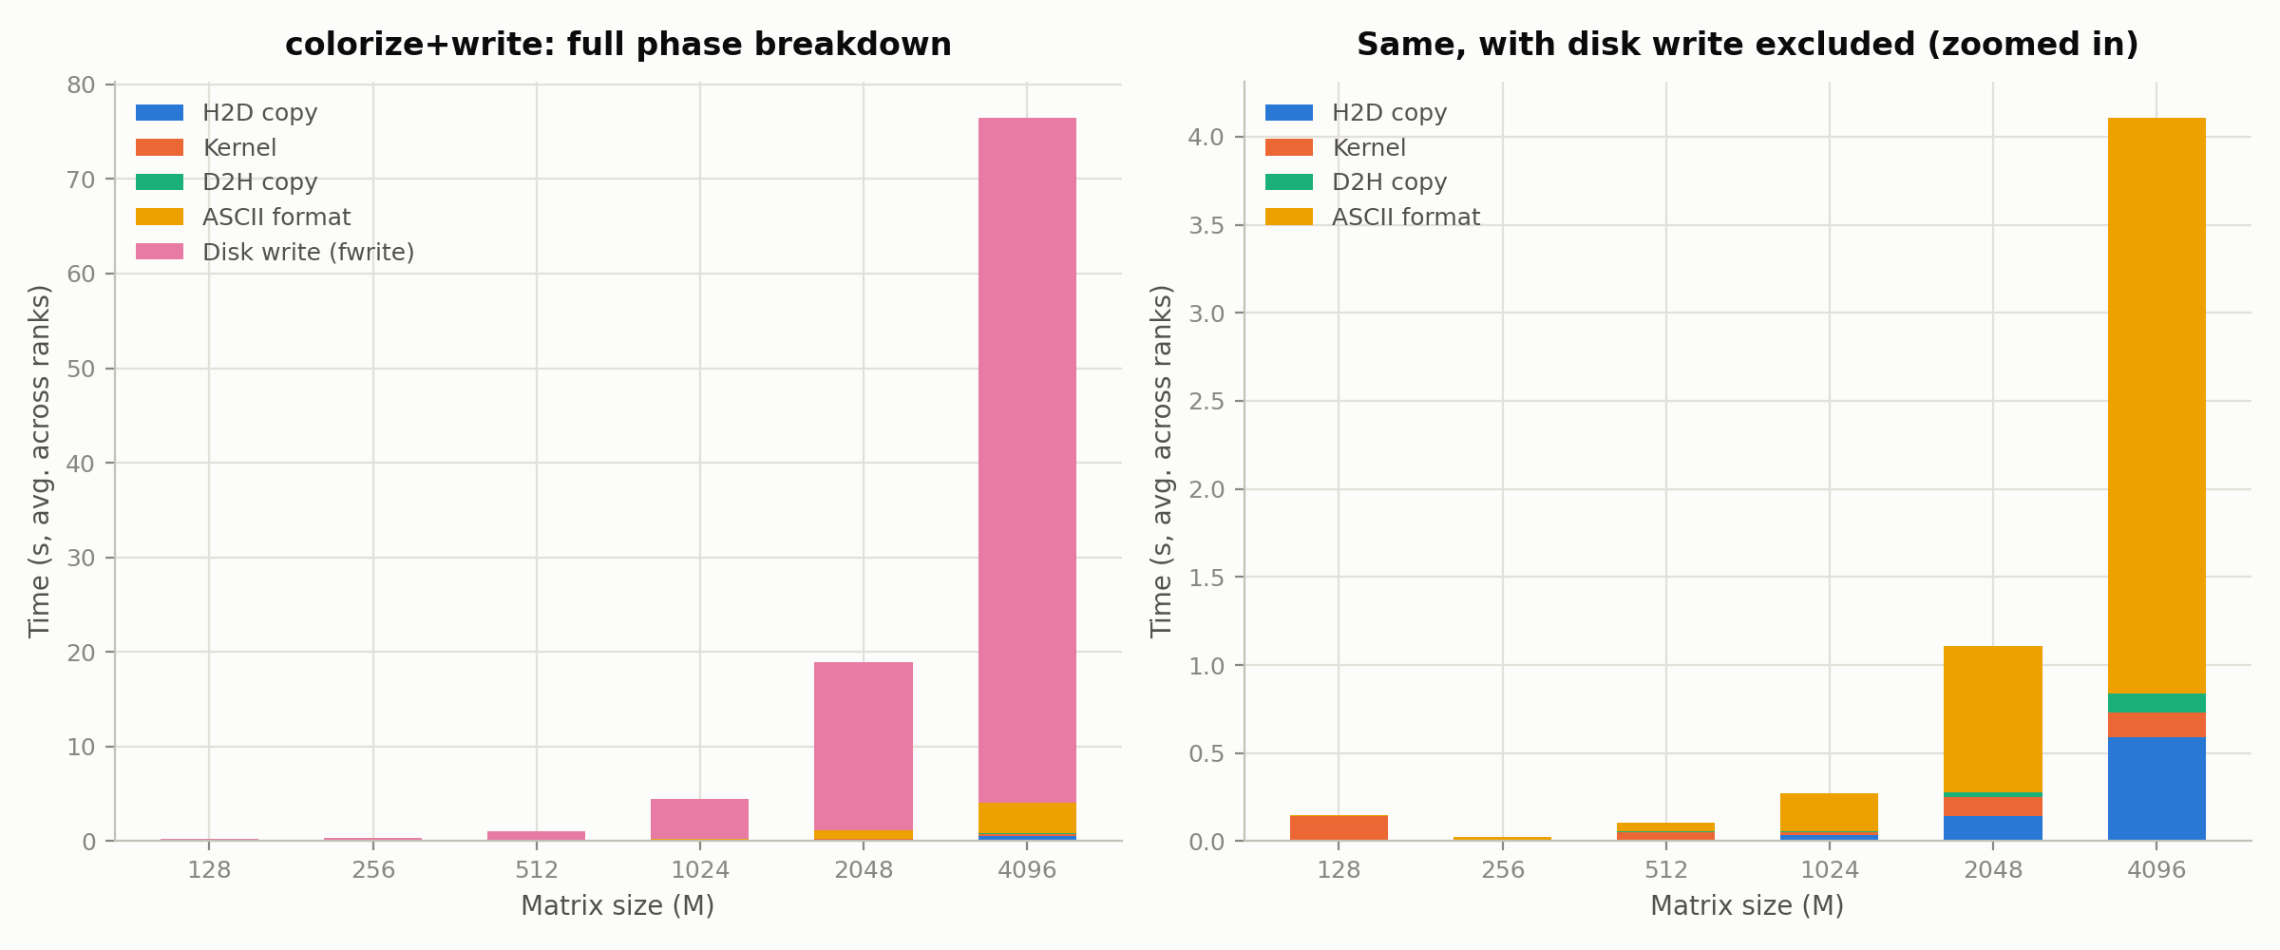
The disk write is 94.6% of the frame cost
At M=4096: write ~94.6%, ASCII format ~4.3%, H2D+kernel+D2H ~1% combined — so parallelizing the ASCII formatting was measured, then rejected.

Slide 12
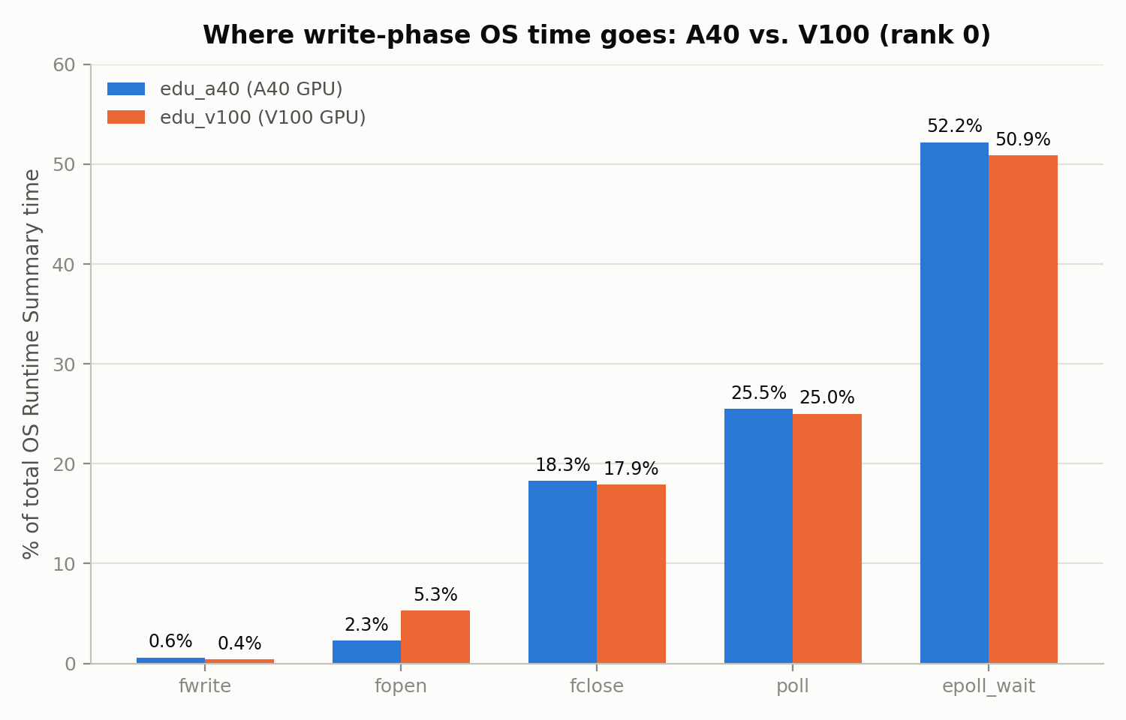
It isn't fwrite — it's fclose, on both GPU generations
Nsight Systems OS Runtime Summary, rank 0. fclose ~18% vs. fwrite ~0.6% — roughly 30× the call it follows. Profile is near-identical on A40 and V100, so the bottleneck is I/O and synchronization, not GPU hardware.
18.3%
fclose
0.6%
fwrite
epoll_wait ~52% + poll ~25% most plausibly reflect ranks idling on MPI progress — reported without claiming a precise causal link.

Slide 13
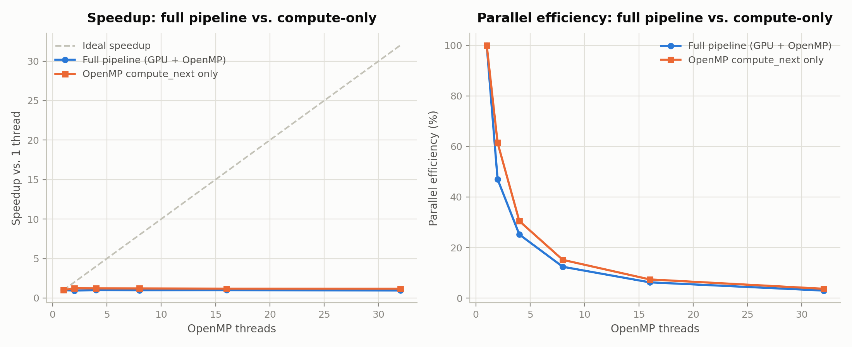
Threads buy nothing: the stencil is bandwidth-bound
1–32 threads at M=4096: both curves flat, never above ~1.2×; compute-only plateaus by 2 threads. Part 1 scaled because it tested M up to 15000 with no competing GPU-bound stage.

Slide 14
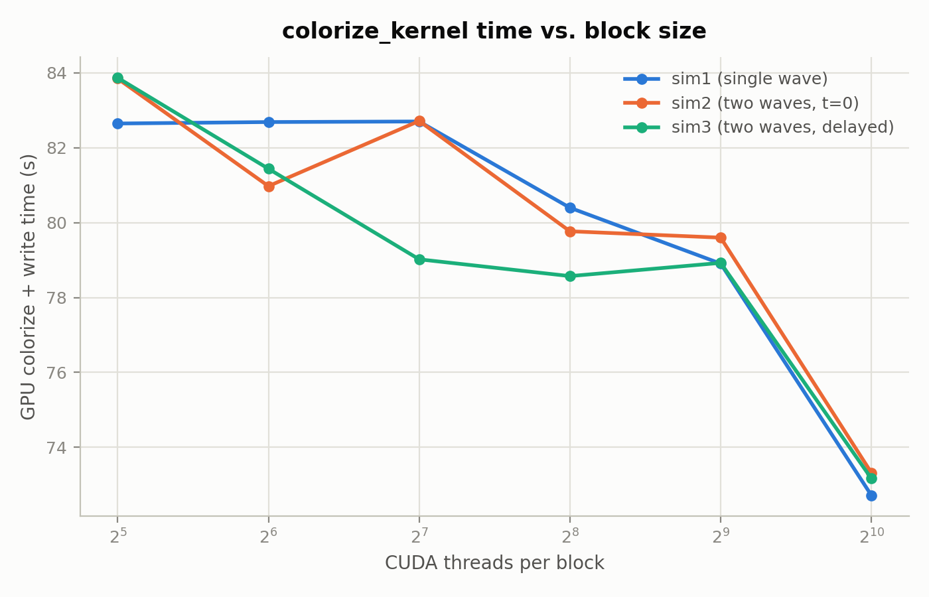
Bigger CUDA blocks win: ~13% from 32 to 1024 threads
M=4096, GPU colorize + write time.
Time falls steadily with block size: ~83–84s at 32 threads/block down to ~73s at 1024 — the largest block tested is also the fastest, so the sweep found no interior optimum.
The three scenarios track each other closely; sim3 is mildly better in the 2⁷–2⁸ mid-range.
~84s
32 threads/block
~73s
1024 threads/block

Slide 15
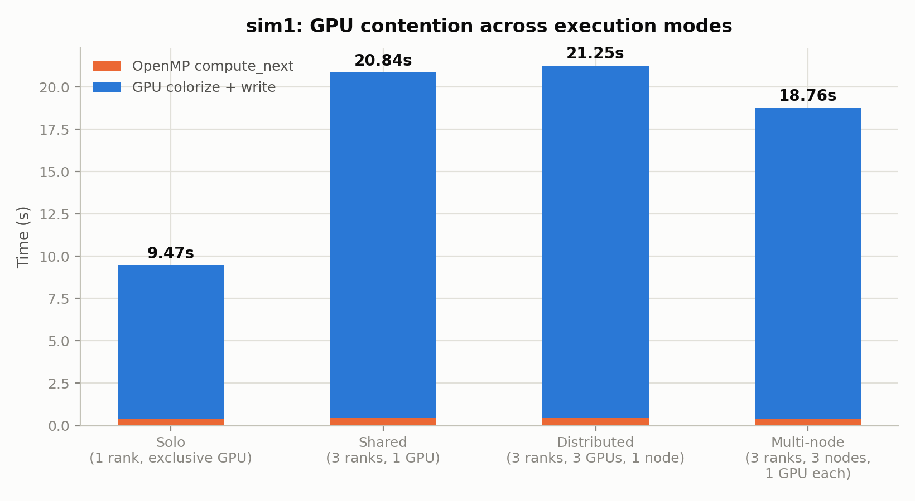
Sharing the GPU is free; sharing the filesystem is not
M=2048, 50 steps, 4 threads — sim1's workload isolated in each mode.
Dedicating a GPU per rank changes nothing: distributed (21.25s) is ~2% slower than shared (20.84s), within noise. Solo is ~50% faster because it is the only mode with a single writer. Multi-node (18.76s) removes host-local contention but still writes to the same shared filesystem.
9.47s
solo, one writer
20.84s
3 concurrent writers

Slide 16
Measure first, then optimize
I/O dominates. Colorization kernel ~1% of frame time, compute_next ~2% — the cost is per-frame file I/O, concentrated at fclose.
Confirmed across hardware. The OS-runtime profile is near-identical on A40 and V100, so it is not GPU-specific.
ASCII formatting: rejected. At ~4% of color_time, parallelizing it could not repay the added complexity.
Adaptive colour scale: adopted. Raw pixel data showed a fixed scale goes pale almost immediately.
Contention is filesystem, not GPU. Four execution modes settled it by measurement, not by spec sheet.
Every optimization decision here was made after measuring — none assumed from the physics or the spec sheet.

